Slide 1

Influenza Season Temporary Staff Planning (2017-18)
Presented by : Alankar Dhumal Data Analytics Team

Slide 2

Safety Moment

Slide 3
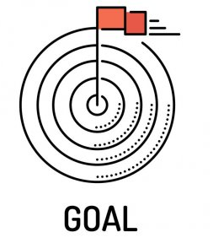







Today’s Agenda
Project Goals
Influenza at a glance
Data sets and Analytical Insights
Data limitations and impact on Analysis
Additional Dataset needs
Our approach to staffing
How to measure our success
Q&A

Slide 4

Project Goals
Optimal Staffing plan
(* A staffing plan that utilizes all available agency staff per state requirements, without necessitating additional resources. )
Staff-to-patient ratio
90% <
<110%
(* Minimal instances of understaffing and overstaffing across states (a state can be considered understaffed if the staff-to-patient ratio is lower than 90% of the required ratio and overstaffed if greater than 110%)

Slide 5


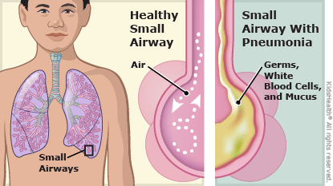
What is Influenza? (Flu)
contagious respiratory illness caused by
influenza viruses
which spread mainly by tiny droplets made when people with flu cough, sneeze or talk
Fatal Flu Complication -Pneumonia

Slide 6







Flu facts
42,000
Flu viruses like cold and dry weather
Claims avg. 42,000 lives in the USA every year
Affects vulnerable population the most
Pregnant Women
Adults >65 yrs.
Vulnerable Population
Children <5 yrs.
Pre-existing diseases
Weak Immunity

Slide 7
Our Datasets
Influenza deaths by geography, time, age
The Influenza death data set is a county-level national mortality and population data spanning the years 2009-2017 produced by the Mortality Statistics Branch, Division of Vital Statistics, National Centre for Health Statistics (NCHS), Centres for Disease Control and Prevention (CDC), United States Department of Health and Human Services (US DHHS).
Source : Centre for Disease Control (CDC) ,USA
Population data by geography
Source : US Census Bureau
As per Wikipedia, the Census Bureau conducts a full population count every ten years in years ending with a zero and uses the term "decennial" to describe the operation. Between censuses, the Census Bureau makes population estimates and projections.[6] "

Slide 8

Analysis Objectives
Analysis Objectives
Explore the seasonality of Influenza over a year
Explore whether different states experience peak Influenza season in different months
Find relationship between number of deaths and magnitude of vulnerable population

Slide 9
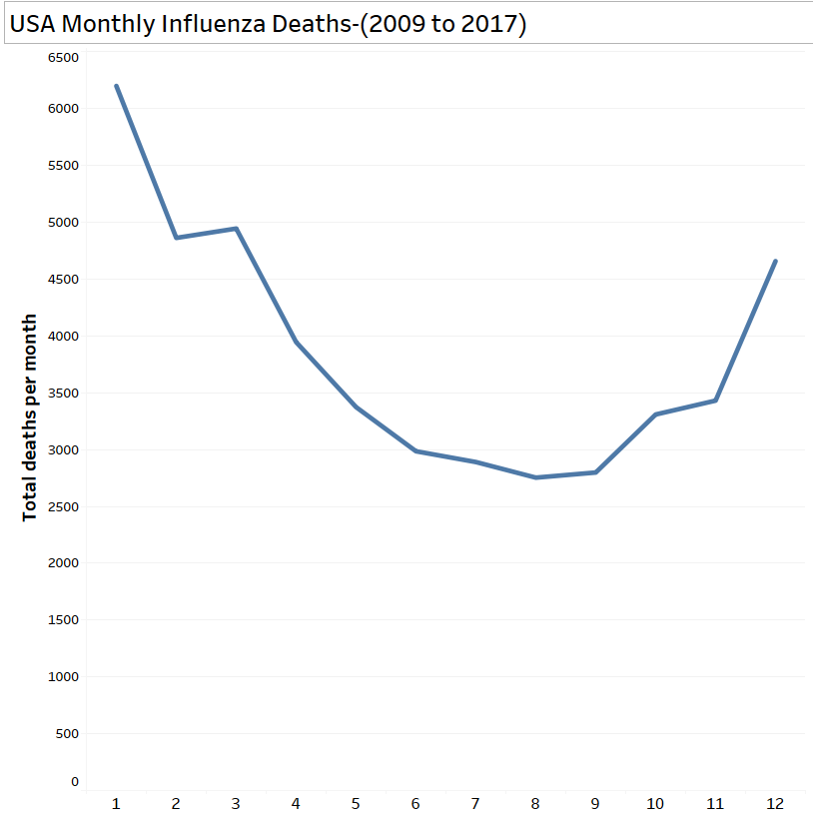
Influenza Seasonality

Slide 10
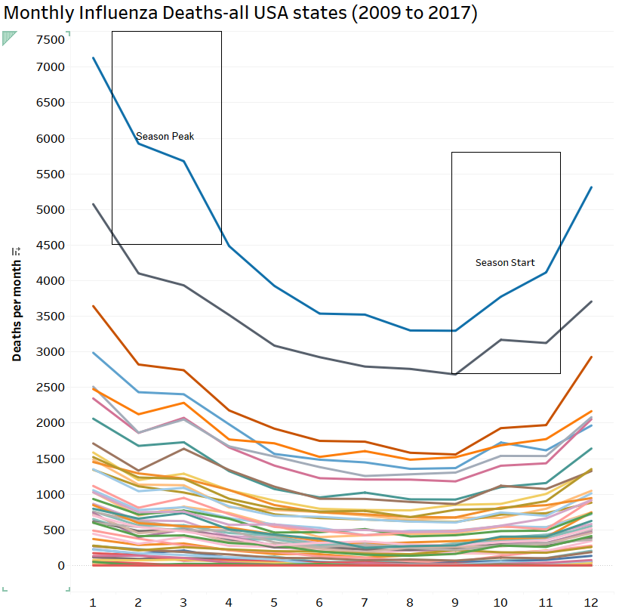
Influenza Seasonality-States

Slide 11
Further Analysis
https://public.tableau.com/app/profile/alankar2299/viz/Excercise-1_16395964555320/Influenza-StoryBoard?publish=yes

Slide 12
Data Limitations and Impact on Analysis
Influenza deaths by geography, time, age
Does not have any data on gender and pre-existing disease
Data is not further sub-divided into counties
“Suppressed” category fields will cause 13% potential error
Suppressed counts are the deaths where the number of deaths not disclosed due to privacy reasons. There are 54,013 corresponding to the grand total of 415,419 deaths. One suppress count can correspond to any number between 1 & 9 .Assuming it correspond to the minimum value of 1 then there will be a 13% potential error.
Population data by geography
Does not provide gender break-up for age groups
This is estimated information based on a 2010 actual census data

Slide 13
Additional Dataset Needs
Must have
Dataset for previous year staffing levels for all hospitals categorised by Nurses, physician assistants and doctors and further categorized as permanent staff and agency staff
Dataset for current agency staff categorised by Nurses, physician assistants and doctors
Dataset of desired Patient-To-Staff ratios for all hospitals
Nice to have
Database further classifying Influenza deaths into gender, pregnancy status ,pre-existing diseases

Slide 14
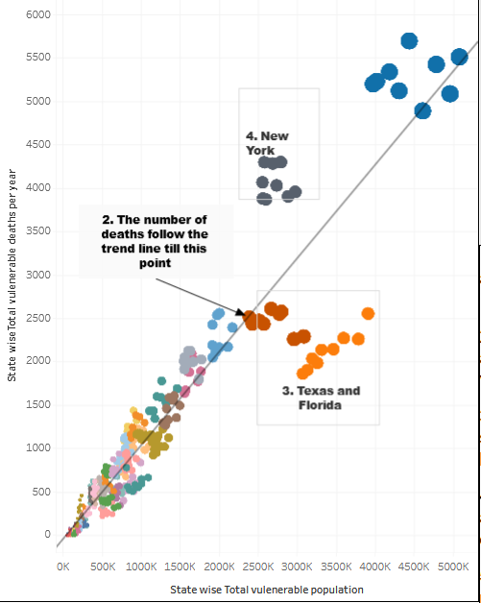
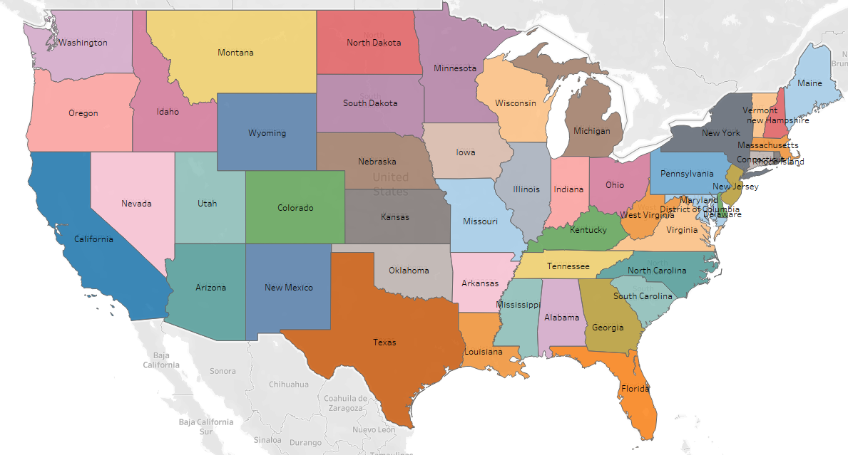
Approach to Staffing
Proposed Overall Staffing Priority
Month of the season
States with more vulnerable population and annual deaths above trend line
More % monthly deaths as compared to others
Alaska will be treated as a special case and decisions will be made based on the local hospital requirements.
To counter transportation delays due to any unforeseen reasons, major state hospitals will maintain a more than average Patient to staff ratio
This approach will be further refined by analysing the trends for individual states

Slide 15
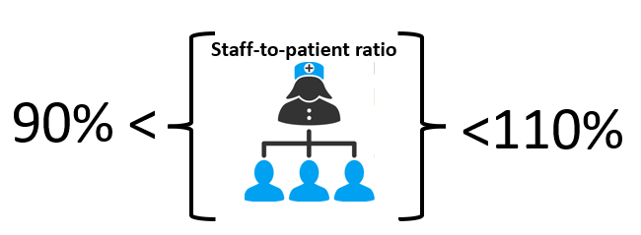


Project Success Measurement
Will be measured in association with the Agency and hospital data tracking teams. Frequency to be agreed
VS
Additional Staff requisitions raised by hospitals then planned
(No requisitions will mean the planning is optimal)
Planned
Required
Average or below average patient wait times
Satisfaction Surveys – Patients, Hospital Permanent Staff, Agency Staff

Slide 16


Thank you

